Slide 1
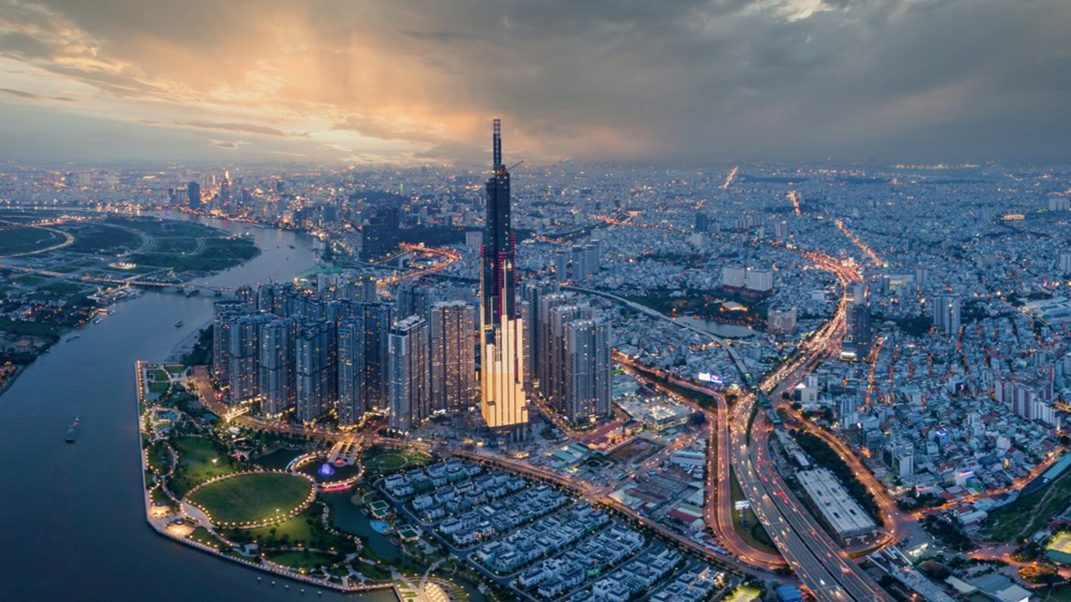
Cultural dimensions
Eito&Haruto
Nov 7
Intercultural communication

Slide 2

Introduction
Name : Kallan Nhu
From : Vietnam
The reasons : our friends
Where : Old main
When : oct 27
How : Talking

Slide 3
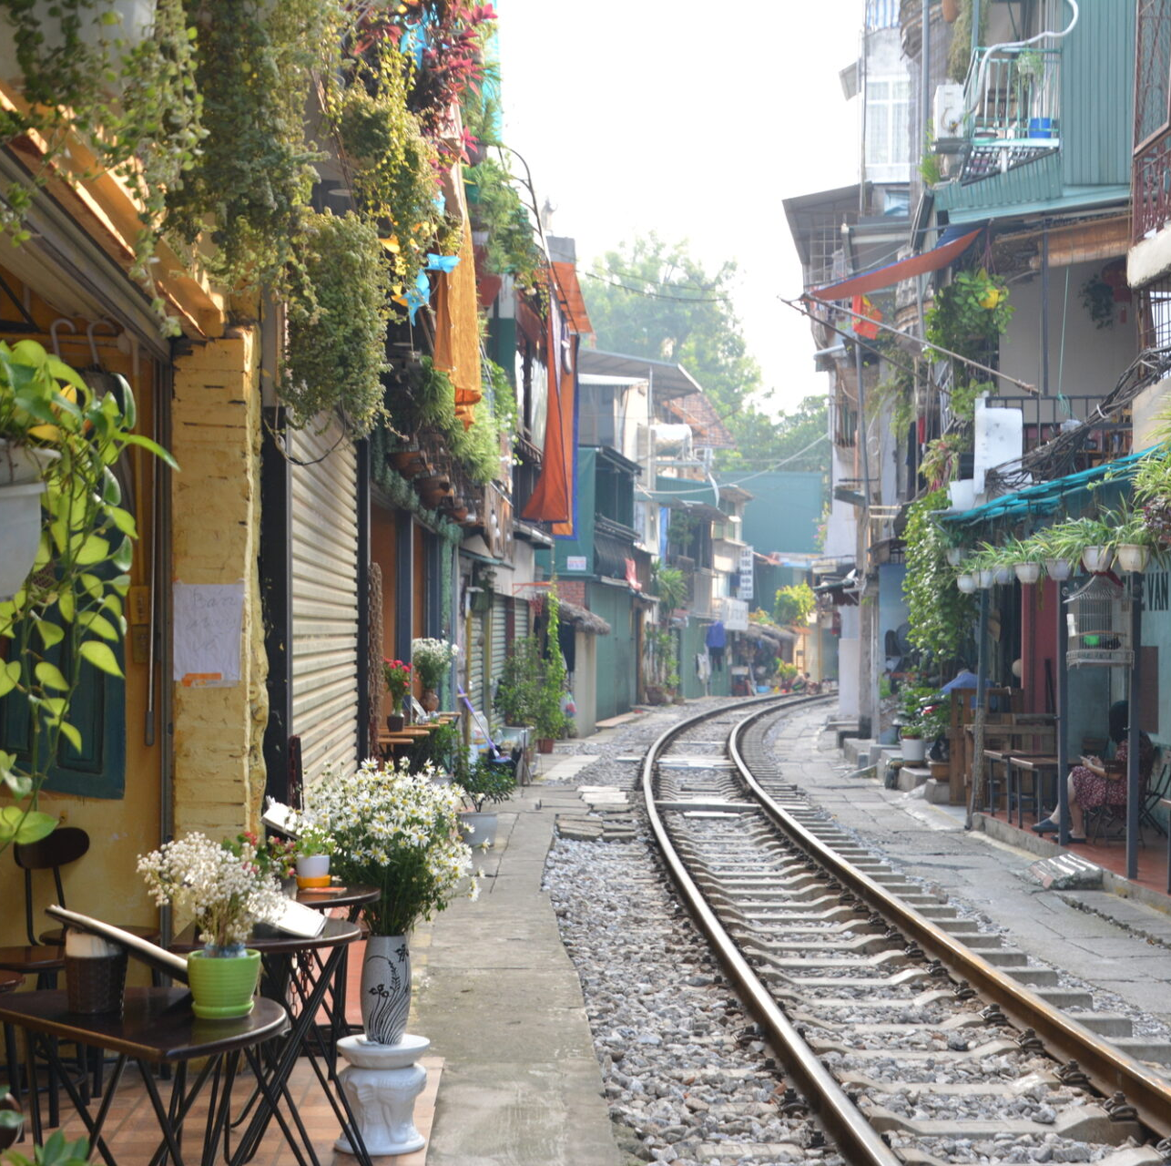
Cultural dimensions
Power distance : How much difference in power
Individualism vs Collectivism : Themselves or their group
Masculinity vs Femininity : Success or quality of life
Uncertainty Avoidance Index : Challenge or stability
Long-term or Short-term orientation : Present or future

Slide 4
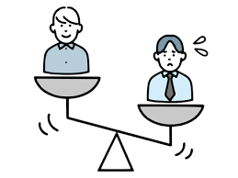
Power Distance
Teacher, Bosses
⇅
＝
High hierarchy
Respectfull
Student ,Employee

Slide 5
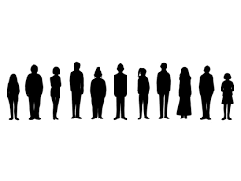
Individualism vs Collectivism
Individualism⇒minority
★Collectivism⇒majority
Why is collectivism more supported?
⇩
※Because working in a group allows people to share ideas and gain more knowledge
than working alone, Vietnam includes a lot of group work in education and society.

Slide 6

Masculinity vs Femininity
Gender role
・Male
・Female → Both are jobs
Most important thing ??
〇Move about success
✖Enjoying their life

Slide 7

Uncertsinty Avoidance Index
Most important ...
Stability
Comfortable＆not risk
In Vietnam : They don't like challenge
⇒Not risk

Slide 8

Long term vs short term orientation
★Long term⇒majority
Short term⇒minority
Why do many people have a long term orientation?
⇩
In Vietnam, people value their income and salary, and by looking at things from a long-term perspective, they think about their future.

Slide 9

Reflection
I learned that culture affects how people live and work.
Men and women both work, and people value stability more than challenge.
I will try to understand other cultures and communicate better in the future

Slide 10

conclusion
Vietnam’s culture shows strong collectivism
It values long-term orientation
It emphasizes cooperation
It focuses on shared growth
It aims for future stability

Slide 11
Thankyou for listening!!

